Slide 1
ASEM – Label Verification Process
Existing Label Verification at Post Test
Proposed Label Verification for Drop Ship Implementation
Prepared by Chong Kim Chor (ASEM-IT)

Slide 2
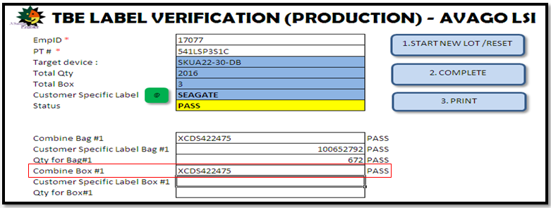
Label Verification System At Post Test (Existing)
All Inner box labels are printed at Post Test and stick on the MBB & Inner Box by Post Test operator, there are INN_GEN1 label and Customer labels.
Existing Label Verification system at Post Test:-
Program developed in excel file.
Linked to Label printing system to get the label information details like device, total qty, total box, end customer, box id and etc.
Linked to MES (FactoryWorks) to block the lot from moving to next step if the label verification is not done.
First scanning done by production.
Second scanning done by QA.
For customer Seagate, Western Digital, INN STDCU label and Cisco Label.

Slide 3
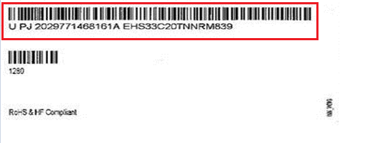
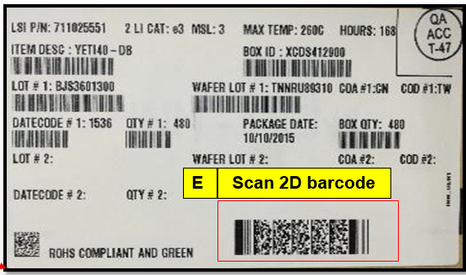
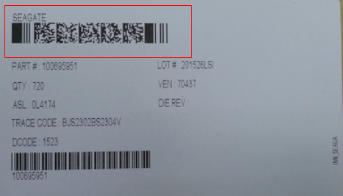
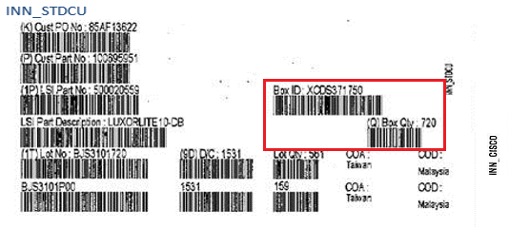
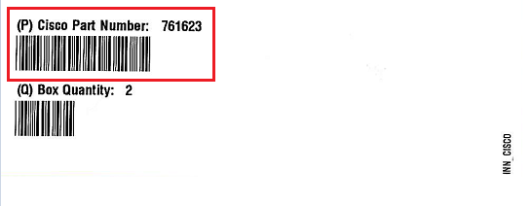
Label Scanning by Production - Existing
Scan labels on MBB:-
INN_Gen1 – 2D barcode.
Customer label – 2D/1D barcode.
Scan labels on Inner Box:-
INN_Gen1 – 2D barcode.
Customer label – 2D/1D barcode.
Barcode that scanned on customer labels highlighted in red in below pictures.
Verification on MBB bag, inner box vs label printing system data. Any mismatched, scan status will be failed. Only all data matched, status will be passed and operator will print out the hard copy scanning result.
INN_GEN1
INN_WDIG
INN_SEAGA
INN_CISCO

Slide 4
Label Scanning by QA - Existing
Scan MBB bag:-
INN_Gen1 – all 1D barcode.
Customer label – all 1D barcode.
Scan Inner Box:-
INN_Gen1 – all 1D barcode.
Customer label – all 1D barcode.
Any of the fields not matched with Label printing history, scanning result will be failed. Lot cannot track out to next steps if the scanning is not complete or result is not passed.

Slide 5
Proposed Label Verification System – For Drop shipment flow (Post Test Production)
Post Test will only print INN_GEN1 label for MBB bag and inner box.
All customers label will be printed in FGI Shipping after received order from customer.
Changes on existing label verification system in Post Test:-
Only verify INN_GEN1 label since there is no customer label print in Post Test.
To ensure operator scan every label (MBB and Inner box label), will make the internal 2D barcode as unique for every label.
Steps:-
Scan Internal Lot no from Residue combine listing document. System will retrieve all information from label printing system.
Scan MBB bag INN_GEN1:-
Scan internal 2D barcode. Internal lot# must matched.
Scan 2D INN_GEN1 barcode. All data in 2D must matched with Label printing system.
Scan Inner Box INN_GEN1:-
Scan internal 2D barcode. Internal lot# must matched and internal 2D value must be different from vapor bag.
Scan 2D from INN_GEN1 barcode. All data in 2D must matched with label printing system.
Scan every box until completely passed. This step is more to ensure no mix label.
Internal 2D barcode:–
MANUFACTURING ID: 536LSWMS01009141017453
Internal ship lot no + box count + hh+mm+ss+mss

Slide 6
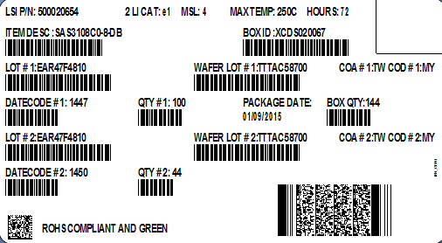
Proposed Label Verification System – For Drop shipment flow (Post Test QA)
Steps:-
Scan Internal Lot no from Residue combine listing document. System will retrieve all information from label printing system.
Scan MBB bag INN_GEN1:-
Scan internal 2D barcode. Internal lot# must matched.
Scan every 1D barcode in INN_GEN1 label. All data must matched with LPS system.
Scan Inner Box INN_GEN1:-
Scan internal 2D barcode. Internal lot# must matched and internal 2D must be different from MBB bag label.
Scan every 1D barcode in INN_GEN1 label. All data must matched with MBB label.
Scan every box until completely passed. This step is to ensure all 1D is able to scan and data are correct.
Internal 2D barcode:–
MANUFACTURING ID: 536LSWMS01009141017453
Internal ship lot no + box count + hh+mm+ss+mss

Slide 7
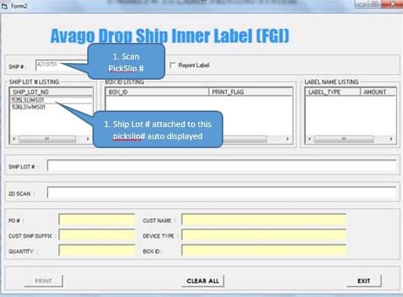
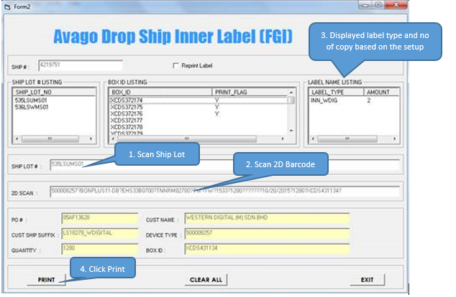
Customer Label Printing in FGI Drop Ship
After received pick slip file, FGI will proceed to picking according to required quantity. Next will print customer label.
To print customer label:-
Scan PickSlip#, system will pull internal ship lot # assigned to this pick slip and all the box id belongs to the internal ship lot# from label printing system.
Scan Internal 2D barcode, internal ship lot # must matched with the ship lot# assigned to the pick slip.
Scan INN_GEN1 2D barcode, system will match the box id and verify LSI part no, part desc and qty from INN_GEN1 label with pickslip data. If is matched, FGI operator will print the customer label. Operator will stick the customer label on the MBB and Innerbox. Proceed to next inner box. Repeat step II & III above.

Slide 8
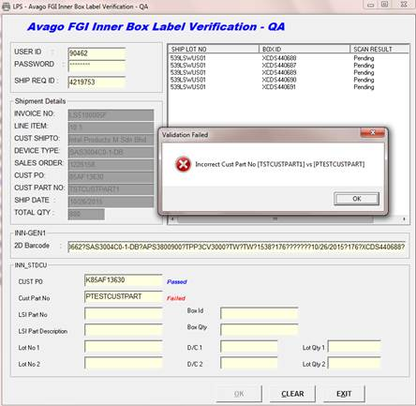
Proposed Label Verification in FGI QA
After completed customer label printing, next is QA to verify and scan the customer label. QA scan the pick slip#, only box id that picked for this pick slip# and already printed customer label will be displayed.
Changes required in existing Label Verification screen:-
MBB Bag:-
Scan internal 2D from INN_GEN1 label.
Scan 2D barcode from INN_GEN1 label.
Scan every field in customer label. Every field must matched with INN_GEN1/Pick Slip info (customer part no/PO No & etc).
Every field must passed in order to proceed
to inner box label scan.
Inner box:-
Scan internal 2D from INN_GEN1 label. Ship Lot # must matched with MBB bag INN_GEN1 but the internal 2D value must be different from MBB label (to ensure QA scan every label).
Scan 2D barcode from INN_GEN1 label. Data must be the same with MBB bag INN_GEN1 2D.
Scan every field in customer label. Every field must matched with INN_GEN1/Pick Slip Info.
Repeat MBB bag & inner box scanning for the next inner box.
Next process is to create the packing list and print the ship request label. If not all boxes scanned, system will block user to print out the ship request label. Every box must scan.

